Slide 1
Neural Interfaces
NX-422
The nervous system
Stéphanie P. Lacour
Giuseppe Schiavone
Neuro-X Institute

Slide 2
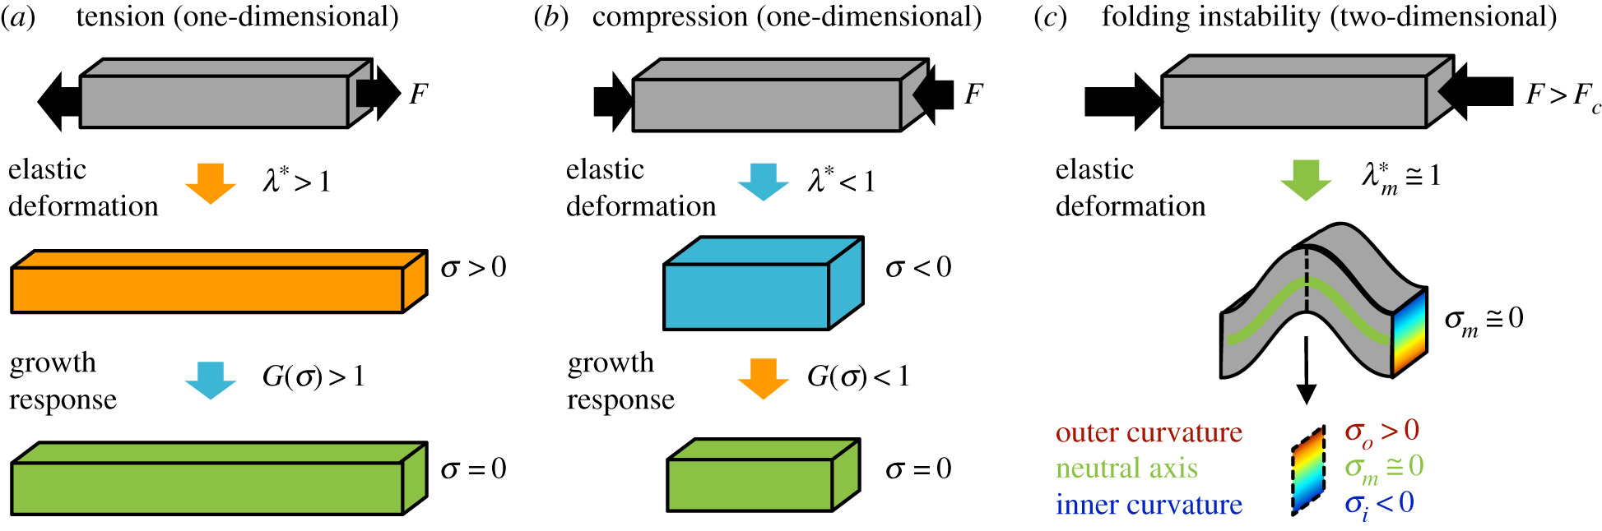
Slide 7 in the main pdf deck Key concept in mechanics

Slide 3

Slide 20 in the main pdf deck - Brain micromotion
Micromotion due to respiration: ≃ 30 μm in magnitude
Micromotion due to vascular pulsatibility: ≃ 3 μm in magnitude
Courtesy of Dr. Alix Trouillet, LSBI, EPFL

Slide 4
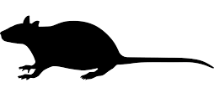

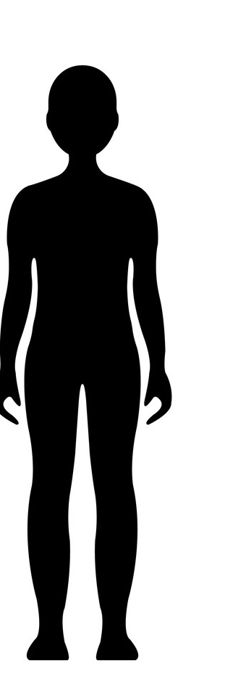
Slide 22
The spinal cord
Shape and dimensions vary
across the length of the spinal cord
across species
MRI scans
and 3D reconstructions
Courtesy of A. Rowald, G. Courtine
EPFL

Slide 5
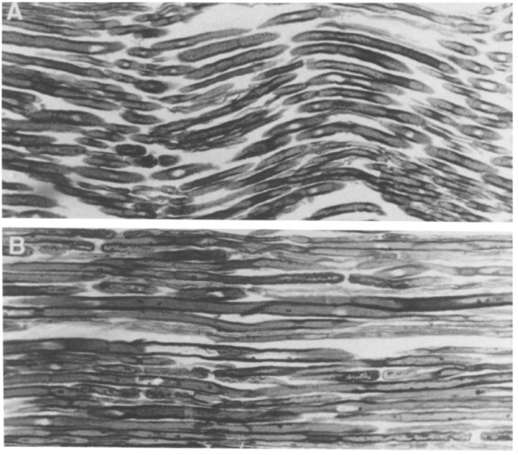
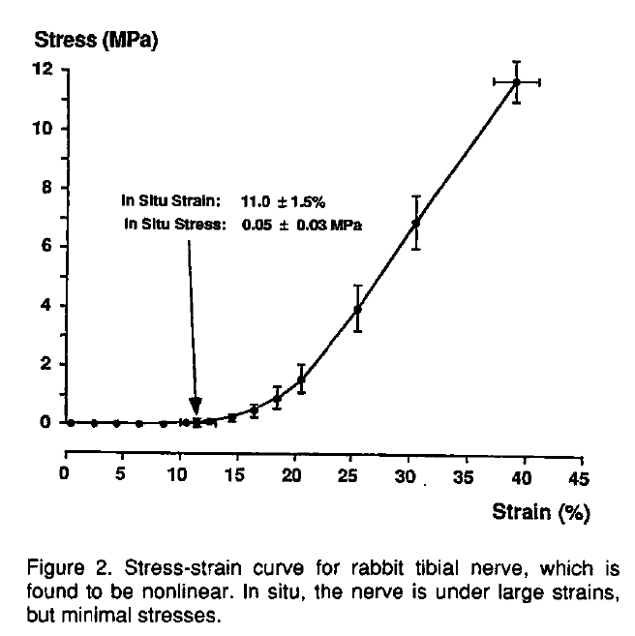
Slide 28 – Mechanical properties of a nerve (tensile)
Bands of Fontana in peripheral nerve
stress = Force / Surface Area
strain = elongation / initial length
nerve
Longitudinal section of nerve showing long waves giving rise to the bands of Fontana.
Nerve held under no tension
Nerve stretched to the point where the bands have completely disappeared
Pourmand, R., et al. (1994). Neuroscience 61(2): 373-380.

